Slide 1
ECE 178 – Discussion 6
Introduction to digital image processing
8th November 2024
Hardik Prajapati

Slide 2
Agenda
HW4 review
HW5 walk through

Slide 3

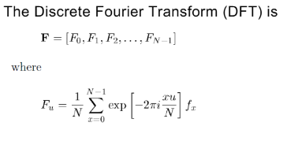


P[n] = [0,1,0,1,0,1,0,1]
F_0 = ½
F_1 = 1/8 * = 0

Slide 4
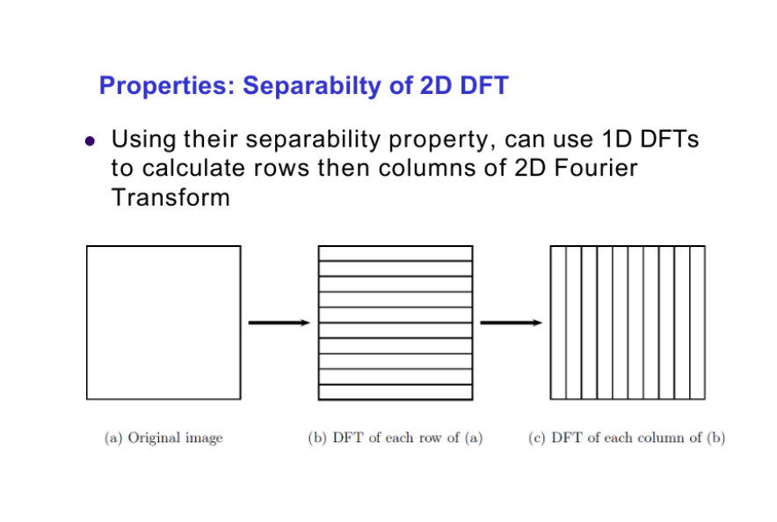
Original Image - f(x,y)
1) Treat all rows independently as 1d signal
2) Do DFT on these signals which will give you new intensity map for each pixel in Fourier space. Let's call this F_row(u,v) (intermediate transform)
3) Using these new intensity/magnitude values (from intermediate transform), compute another set of DFTs' on each column treating them independently.
4) This will give you new values for each pixel which will be the final DFT transformed space. F(u,v)

Slide 5
X(n)
1 | 2 | 3 | 4 | 5
1 | 4 | 10 | 16 | 22 | 22 | 15
H(n)
1 | 2 | 3
Output : Y(n)
Step 1: Invert either the signal or the filter
3 | 2 | 1
Step 2:
1 | 2 | 3 | 4 | 5
3 | 2 | 1
= 1
Step 3:
1 | 2 | 3 | 4 | 5
3 | 2 | 1
= 4
Step 4:
1 | 2 | 3 | 4 | 5
3 | 2 | 1
= 10
Step 7:
1 | 2 | 3 | 4 | 5
= 22
3 | 2 | 1
Step 8:
1 | 2 | 3 | 4 | 5
= 15
3 | 2 | 1

Slide 6
Motion Blur Approximation
Table corresponds to the location of image at each frame captured
Image output is the average of these frames
How would you represent this as a kernel?
X | Y
1 | 1
2 | 2
3 | 3
 |  | 1
 |  |  | 1
 |  |  |  | 1

Slide 7
Demonstration – VSCode file HW4 review

